Slide 1
Food Price Prediction in Bangladesh
Presented by:
Mst. Nishi Khatun
ID:152311028
Batch: 9th Sem: 11th
Supervised by:
Nafi-Us-Sabbir Sabith
Lecturer,
Dept. of CSE,
Varendra University.)

Slide 2
Problem Definition
The food price of commodities fluctuate in Bangladesh very drastically. This causes problems for both consumers and business organization. A good prediction of food prices can help in this regard.
Keywords:
Regression analysis ,
Time Series Analysis,
Neural Network,
Data Mining,
Food Price Forecasting,
Market Risk Analysis

Slide 3
Motivation
Sociological impact
Market Risk Analysis and Management

Slide 4
Background study
Previous research works
Agricultural price forecasting using neural network model: An Innovative information delivery system
The superiority of ANN over linear model methodology has been demonstrated using monthly wholesale price series of soybean and rapeseed-mustard. It has also been observed that combining linear and non linear models leads to more accurate forecasts than the performances of these models independently, where the data show a nonlinear pattern.

Slide 5
Background study(2)
Previous research works
2. Short term price forecasting for Agro-products using artificial neural network
It is well known that short-term market price forecasting has been a difficult problem for a long time because of too many factors which can not be accurately predicted. Conventionally, time series analysis has been often employed in modeling short-term price forecasts. He has demonstrated that ANN, a new technique, is an efficient tool for modeling and forecasting.

Slide 6
Background study(3)
Previous research works
3. A machine learning approach to forecasting consumer food prices
Forecasted the Canada Consumer Price Index (CPI) to assess the performance of various machine learning techniques against three data model.
His results showed that a model of artificial neural network with backpropagation and another with multilayer perceptron out performed the other machine learning techniques ( multivariate regression, support vector machine, decision tree)

Slide 7
Background study(4)
Previous research works
4. Real Estate Price Prediction with Regression and Classification
Baseline model for classification is Naive Bayes. They implemented two types of Naive Bayes: Gaussian Naive Bayes and Multinomial Naive Bayes.

Slide 8
Background study(5)
Other Notable Problems solved Using ANN :
Forecasting foreign currency exchange rate
Predicting stock market
Forecasting the end of year net asset value
Forecasting electricity price

Slide 9
Background study Findings
Limitations of traditional models
Time series and
Regression analysis both can not learn the complex input output relationship through a supervised training process with historical data .
Advantages of neural networks :
Feed forward (Multi Layer Perceptron),
Back propagation and
Recurrent neural network - all has its own set of advantages and disadvantage.
So we will not use statistical models and we will compare the performance of the neural network models

Slide 10
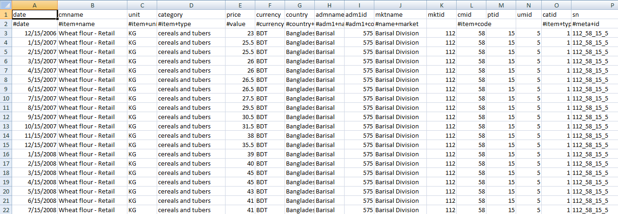
Data set
Source: WFP-World Food Program
Size: 3412
Timeline: Jan 15, 2004 – Sep 15, 2018.
Expected Update Frequency: every week
Type: time series

Slide 11
Methodology
Data pre-processing
Preparing a class object from the survey data
Normalizing the data
Classification model :
Feed Forward ANN(Multi Layer Perception),
Back Propagation-ANN and
Recurrent ANN
Result visualization
Decision/ Prediction

Slide 12
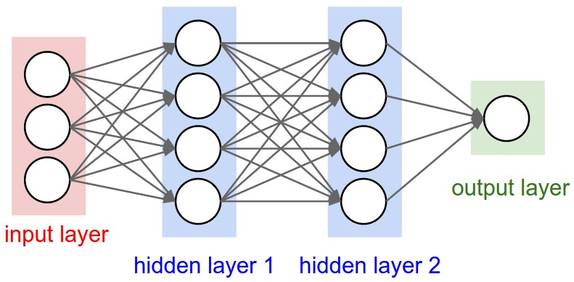
Classification model : FF- ANN(MLP) configuration

Slide 13
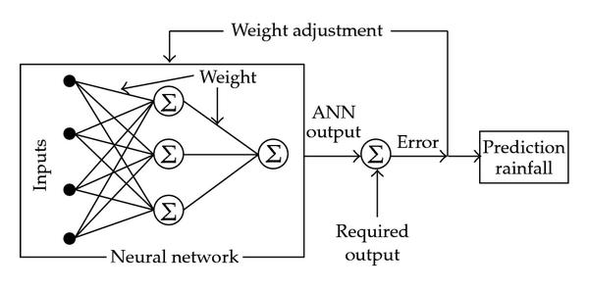
Classification model : BP- ANN configuration

Slide 14
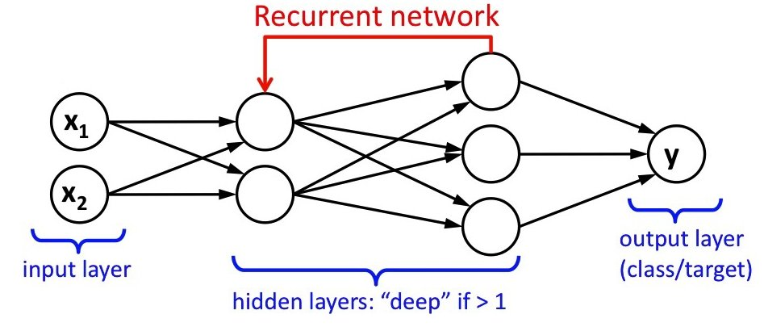
Classification model : RNN configuration

Slide 15
Challenge
Less quantities of clean and correct training data will produce bad quality forecasting models.
The fluctuation of the food prices in Bangladesh makes it hard to select the appropriate features.

Slide 16
Technology stack
CSV files for data collection
Java OOP for data pre-processing
WEKA for classification and prediction
Artificial Neural Network Models
Implementation: perceptron , back propagation
Deeplearning4j framework

Slide 17
Future works/ goals
Spatial (division wise) prediction of food prices.
Commodity price trends per category

